Slide 1
Ion Solvation by Organic Solvents Driven by Hydrogen Bonding Interactions
Andrew Eisenhart, Thomas Beck
Closed Defense Presentation
2/3/2021

Slide 2
Projects Covered
Project 1 : Glycerol Carbonate’s Dependence on Hydrogen Bonding for it’s Liquid Structure and Solvation Behavior.
Projects 2 / 3 : Calix-N-Arene Macrocycle and Host-Guest chemistry Tuning with Hydrogen Bonding Functional Groups
Project 4 : Tuning Phenothiazine Phase Preference for Redox Flow Batteries.

Slide 3
Project 1 : Glycerol Carbonate
Behavior as a pure liquid and as a solvent of ions

Slide 4
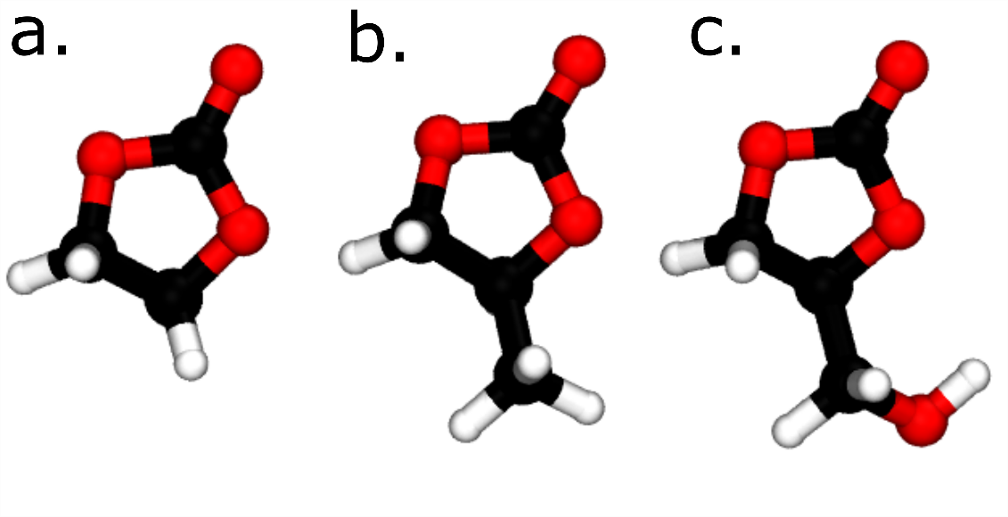
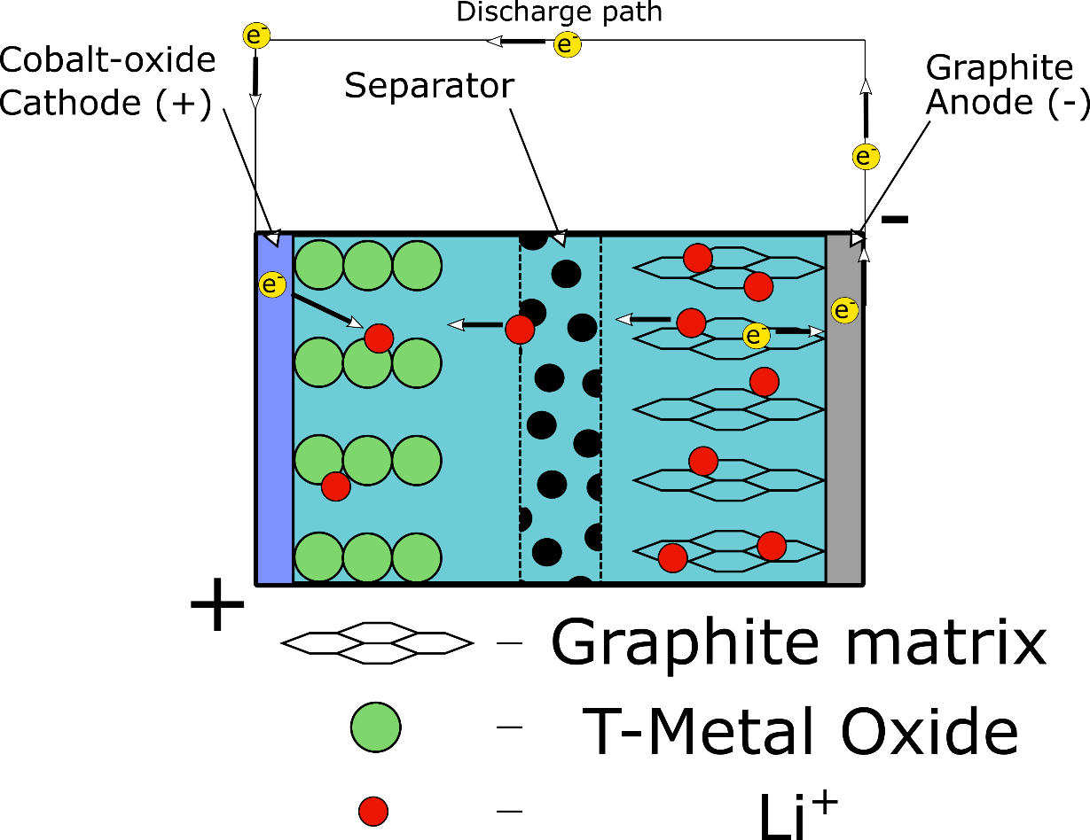
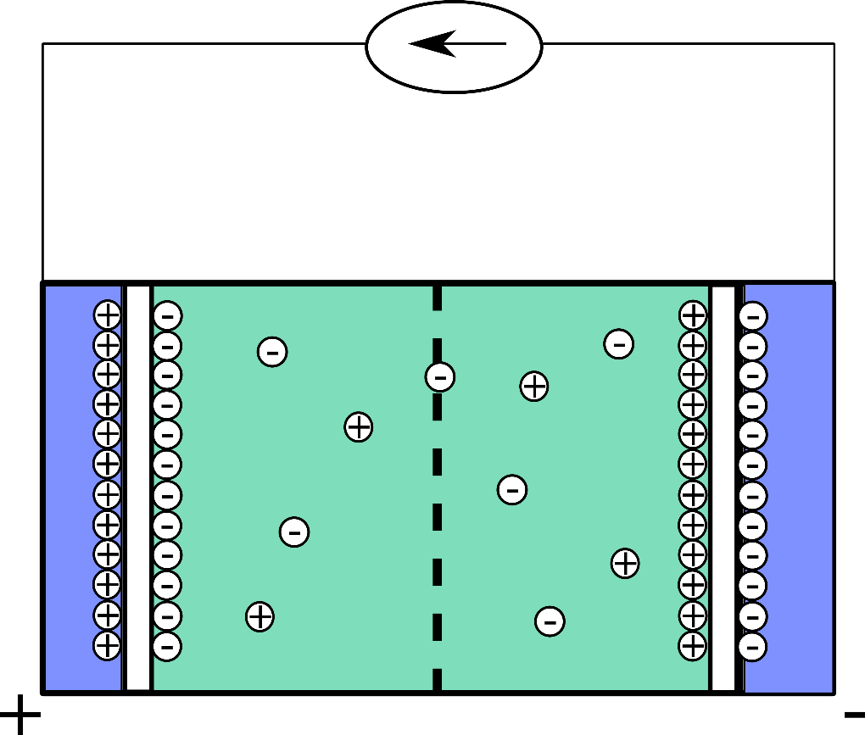
Organic Carbonate Solvents
Widely Reactive
Ethylene Carbonate EC (Li+ batteries)
Propylene Carbonate PC (Super Capacitors)
Glycerol carbonate GC
Valorization of Glycerol
EC
PC
GC
Green Solvent
Energy Storage?
Lithium ion battery
Super Capacitor
Electrolyte

Slide 5
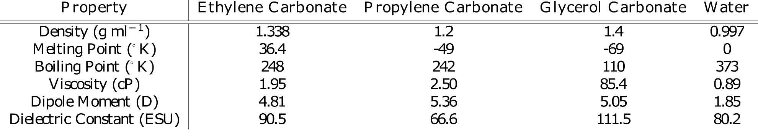
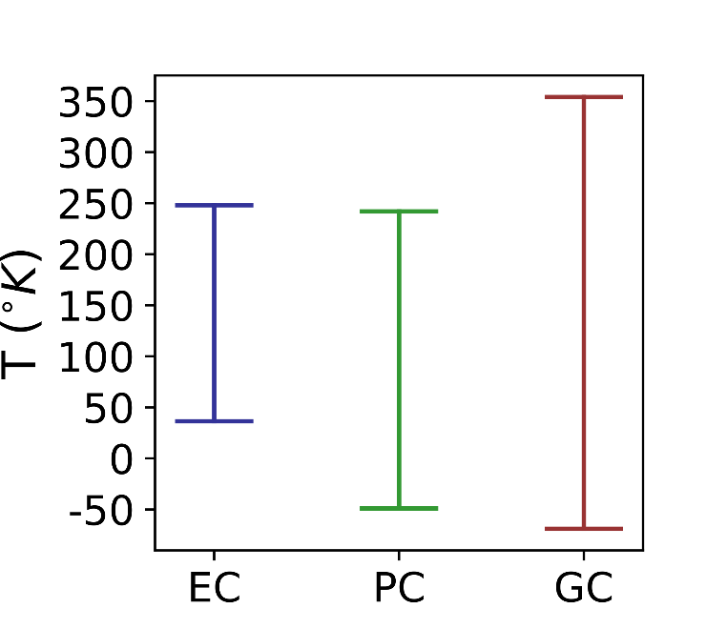
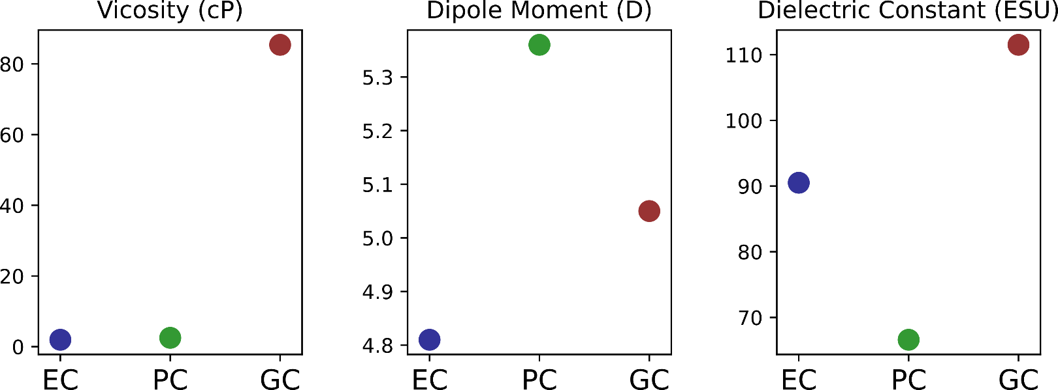
Physiochemical effects of Tail Functionalization
EC
PC
GC
C
C
Effective
temperature
range:
GC > PC > EC
C

Slide 6
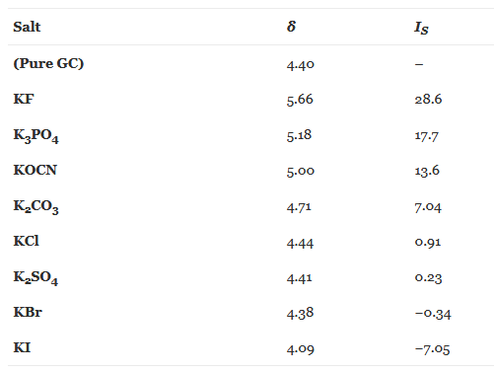
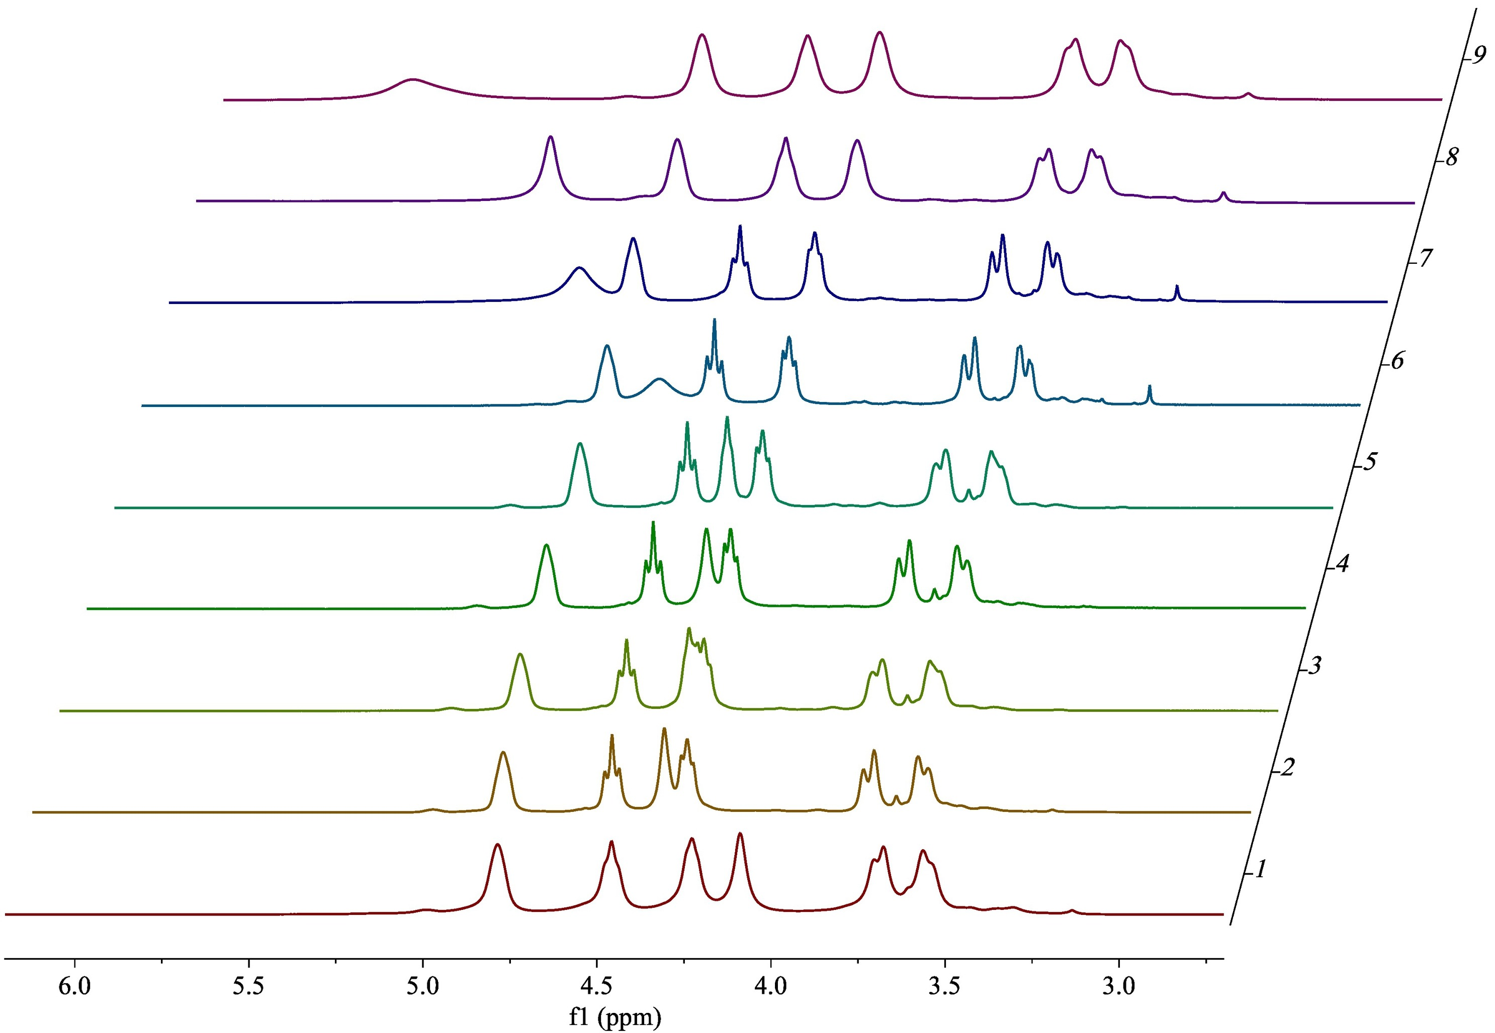
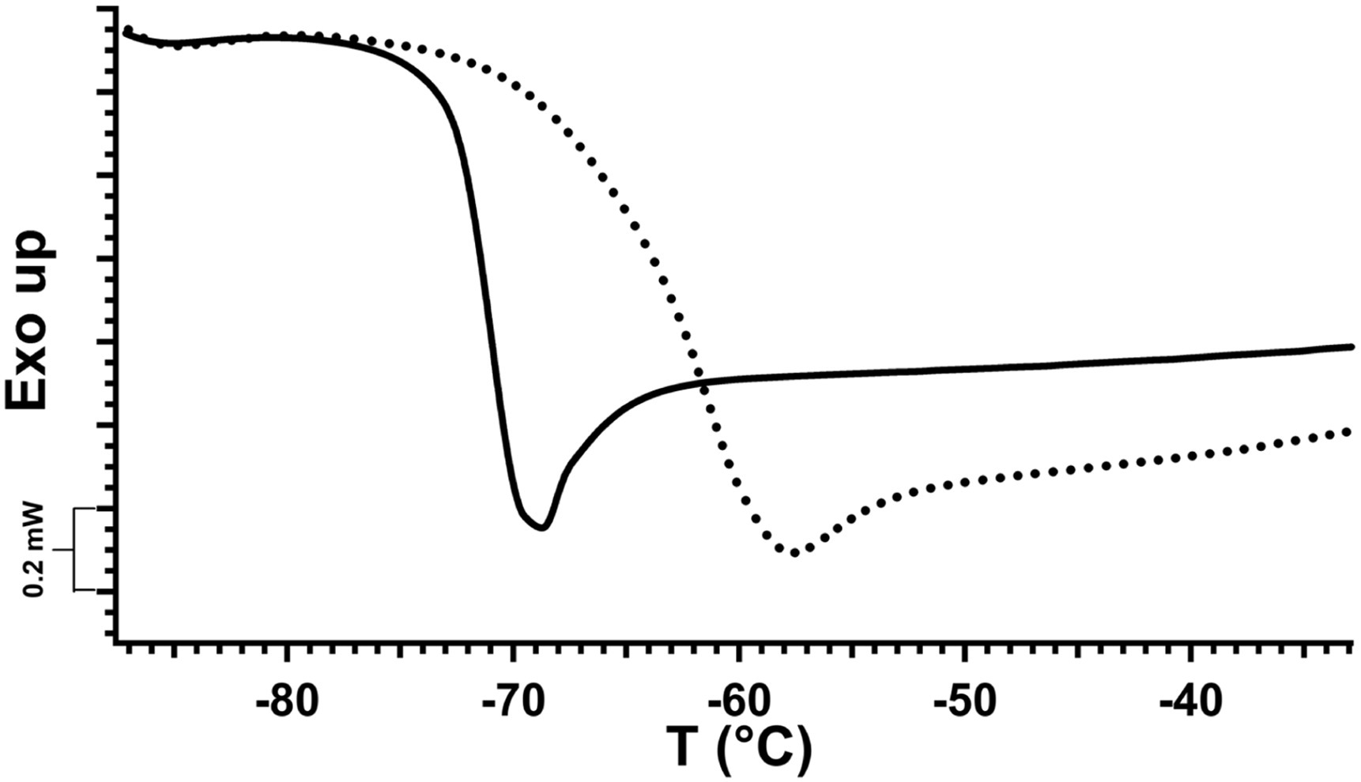
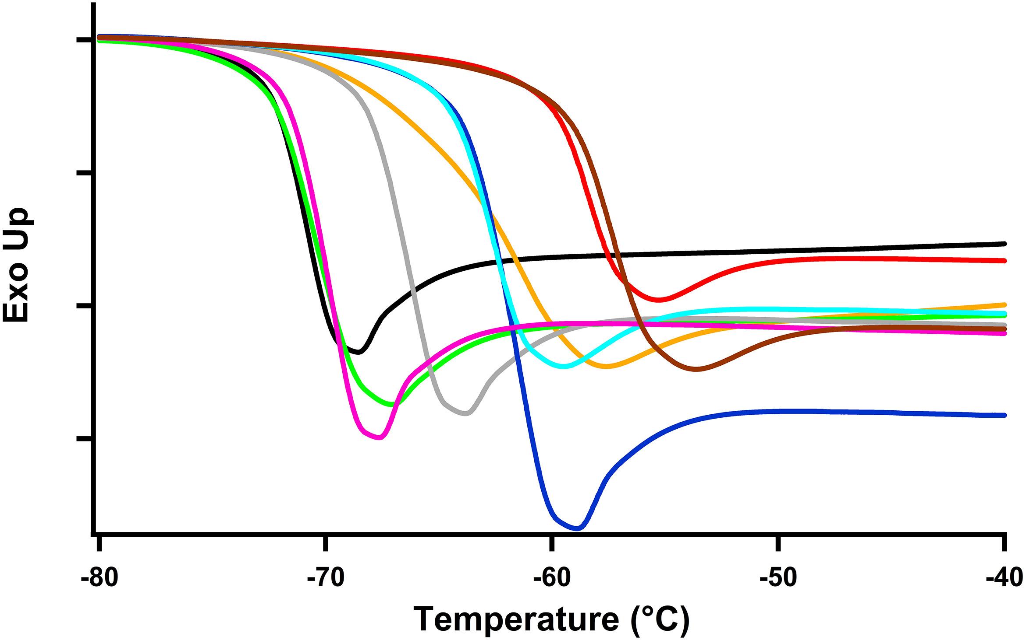
Interesting Phenomenon Involving Glycerol Carbonate
Addition of electrolytes to GC allow a dense glassy phase to form at room temperature. Increasing the transition temperature by ~10 °C.
However this effect is limited to select electrolyte pairs
pure gc
gc plus KF
pure gc
Differential scanning
calorimetry
gc - KCl
gc - KF
Sarri, Filippo, et al. "Specific ion effects in non-aqueous solvents: The case of glycerol carbonate." Journal of Molecular Liquids 266 (2018): 711-717.
Sarri, Filippo, et al. "The curious effect of potassium fluoride on glycerol carbonate. How salts can influence the structuredness of organic solvents." Journal of Molecular Liquids 255 (2018): 397-405.

Slide 7
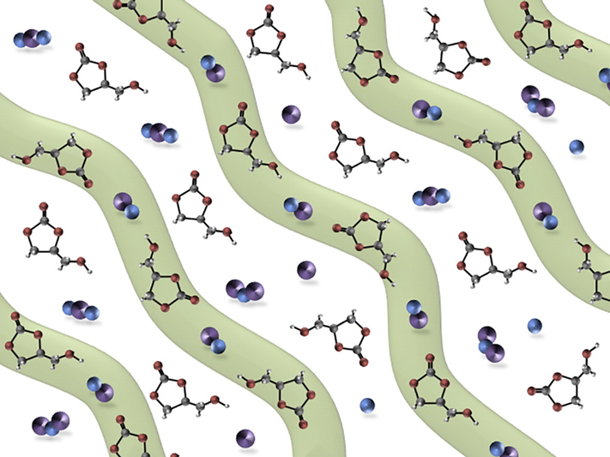
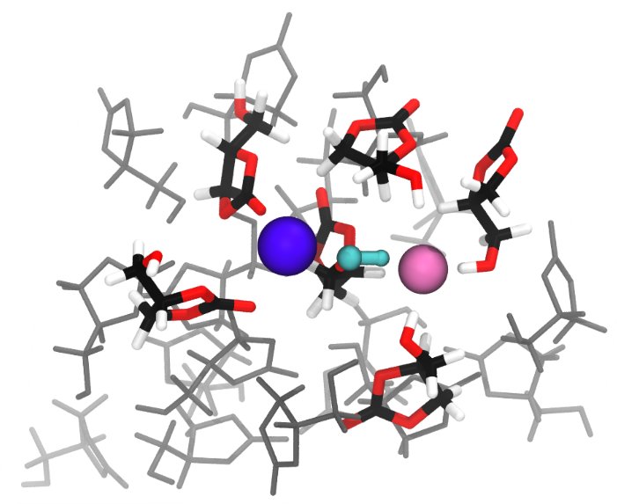
Project Goals
Origin of GC’s peculiar physiochemical properties?
Compare GC’s liquid structure and dynamics to EC and PC.
Discover microscopic details that cause the interesting behaviors of GC electrolyte solutions.
Methodology
Classical molecular dynamics (GROMACS md suite, OPLS-aa force field).
Density functional theory molecular dynamics (DFTMD / AIMD, cp2k) RevPBE-D3/DZVP-MOLOPT-SR-GTH.
Quantum Electronic calculations and analysis (ORCA, PSi4, bader charge analysis, multiwfn)
Systems ranged from 32 molecules (AIMD) to 2000 (classical).
Liquid structure of GC-KF proposed by Sarri et al
Sarri, Filippo, et al. "The curious effect of potassium fluoride on glycerol carbonate. How salts can influence the structuredness of organic solvents." Journal of Molecular Liquids 255 (2018): 397-405.

Slide 8
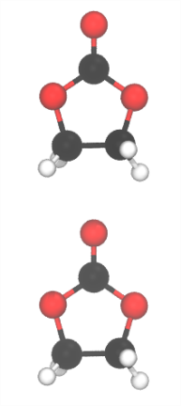
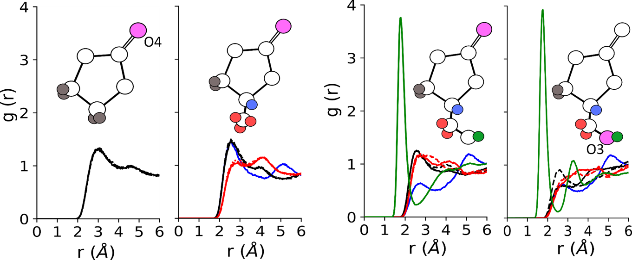
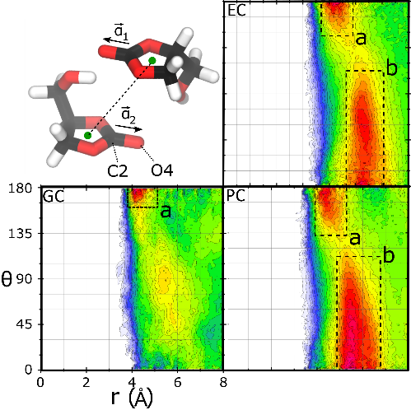
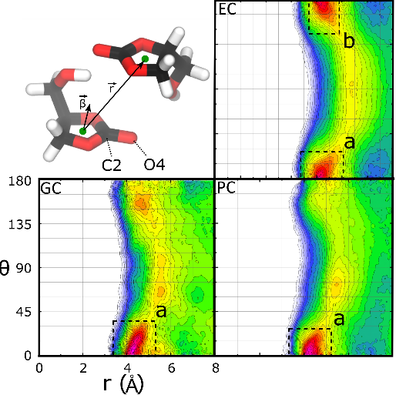
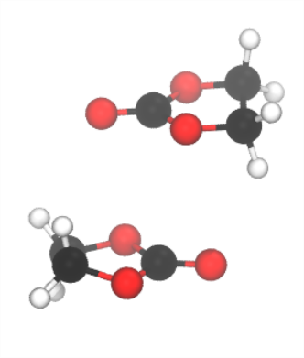
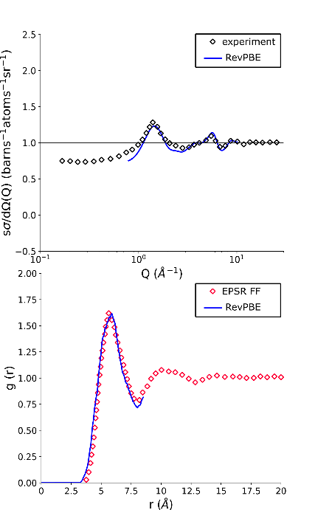
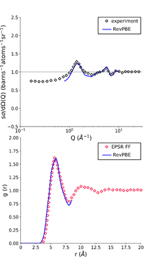
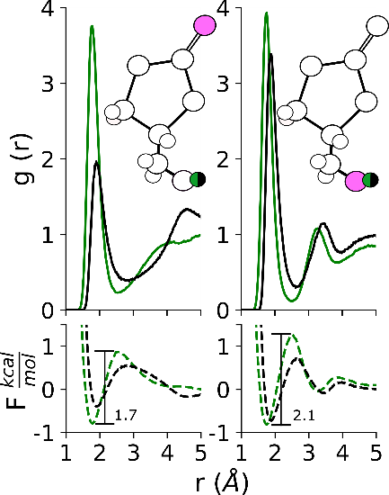
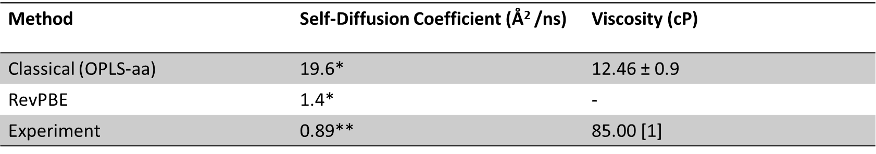
Pure Liquid Results
Dominant interactions in EC, PC are between the Carbonyl and ‘tail’ of two molecules.
Dominant interaction in GC are between the hydroxyl group and the carbonyl / hydroxyl oxygen
of neighboring GC molecules
This leads to
The formation of chains and bi-directional molecular stacking in EC.
The formation of chains and monodirectional stacking in PC.
The formation of monodirectional stacking in GC.
This results in GC being more disordered than the other two liquids, but with larger intermolecular interactions.
This means the liquid has a high viscosity, but is liquid at
a larger range of temperatures.
AIMD simulation methods seem necessary to obtain dynamic and structural quantities comparable to experiment (structure factor / viscosity).
Chain dimer
Stacking dimer

Slide 9

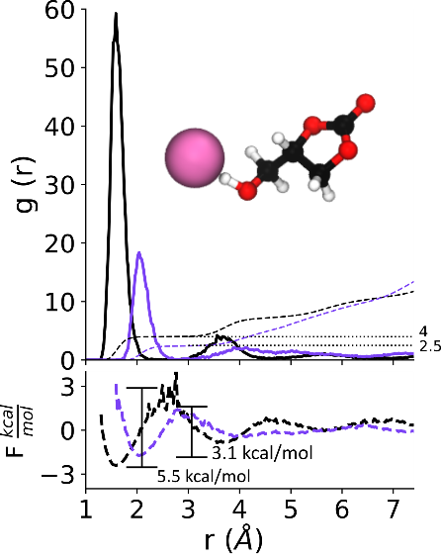
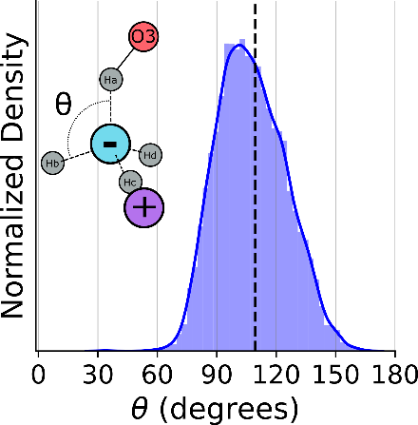
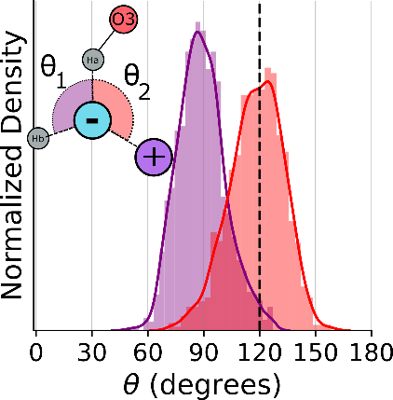
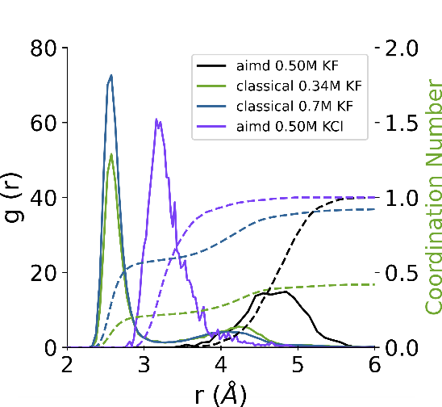
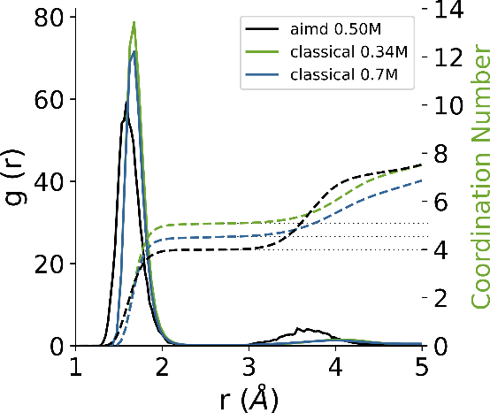
GC - Electrolyte results
GC primarily interacts with the studied Anions (F/Cl) through its hydroxyl hydrogen.
GC primarily interacts with the studied Cation though its carbonyl and hydroxyl oxygens.
The KF ion pair exists in the simulations as a shared solvent ion pair with a stable secondary solvation shell around the fluoride ion. The shared solvent molecule orients to insert its hydroxyl tail in between the ion stabilizing the geometry.
The KCl ion pair exists as a contact ion pair, and has a reduced secondary solvation shell when compared to KF.
The solvation geometry and charge transfer of K, Cl, and F in GC was also reported.
F solvated by 4 GC’s in a tetrahedral geometry, Cl by 2 GCs on average, K by 5 GCs as a mixture of O3 and O4.
KF vs KCl
KF vs KCl vs classical

Slide 10

Result Summary
The magnitude of H-Bonding interactions in pure GC and their effect on liquid structure and dynamics have been quantified using conventional MD metrics (RDFs, PMFs) and a novel spatial metric (RDF-ADF combined distribution functions) .
The necessity of sophisticated modeling methods for organic carbonate solvents has been reaffirmed in the pure and electrolyte system.
The potential underlying mechanisms behind the peculiar behaviors of pure and electrolyte GC have been identified and examined.
Future
My most recent simulations involve the solvation of Li⁺, PF₆⁻, and I⁻ by GC. Our goal with these simulations is three fold.
To gain insight into the specific solvation of these important ions.
To examine the differences in second shell solvation when progressing down the halogen family F>Cl>Br>I.
To see if a link exists that can be exploited between classical viscosity calculations results and AIMD solvation structures.
Resulting Publication
Journal: The Journal of Physical Chemistry
Part: Part B: Biophysics, Biomaterials, Liquids, Soft Matter
Title: "Quantum Simulations of Hydrogen Bonding Effects in Glycerol Carbonate Electrolyte Solutions"
Authors: Eisenhart, Andrew; Beck, Thomas
Manuscript ID: jp-2020-10942d.R2
Manuscript Status: Accepted
DOI: 10.1021/acs.jpcb.0c10942

Slide 11
Projects 2 / 3 : Calix[n]Arenes
Calix-n-Arene macrocycles as host molecules, and drug chaperones
in collaboration with Arnab Dawn, Frank Heinrich, and Dr. Harshita Kumari

Slide 12
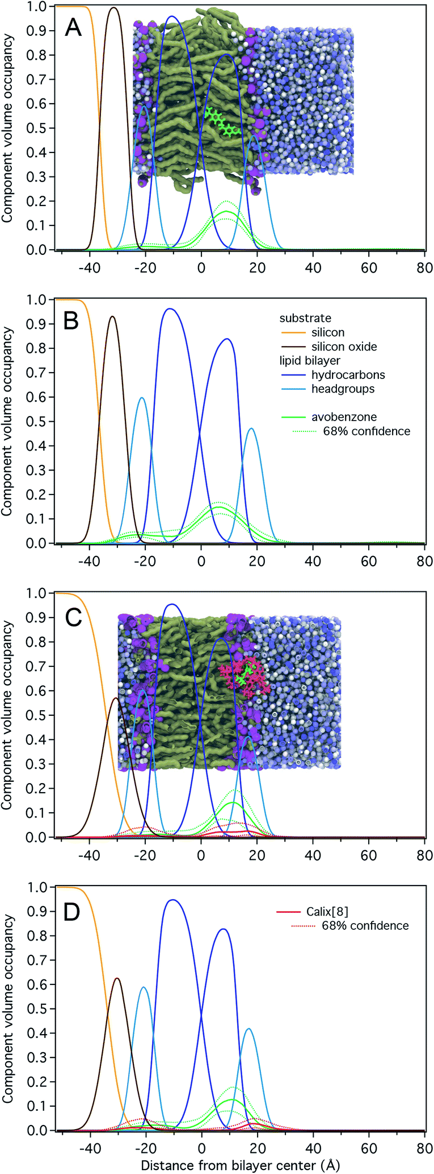
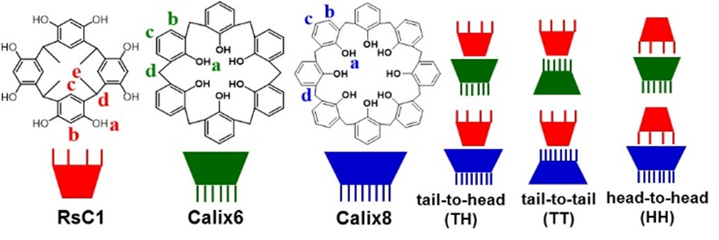
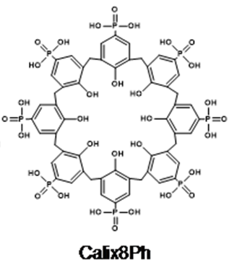
Calix[n]Arenes
Cyclic oligomers of several phenolic units connected with methylene bridges.
“Bowl” structure allows them to naturally act as host molecules with a tunable cavity size.
Host to drug molecules or capture unwanted species
Soluble in water when functionalized with hydrogen bond forming groups (i.e Calix8Ph).
Non-toxic to humans.

Slide 13
Projects
Investigate the driving forces and geometry of self-assembling calixarenes
Goal
Simulate various combinations of calixarenes in different self assembly conformations to identify:
The most favorable conformation.
The most favorable combination of calixarene sizes.
Investigate the ability of Calixarenes to act as a chaperone molecule for avobenzone and curcumin.
Goal
To quantify the effect on membrane permeation that Calixarene macrocyles have on common drug molecules; avobenzone and curcumin.
Common Methodology
All simulation were run using classical representations for the molecule and atoms (GROMACS md suite, CHARMM36 force field)
Methanol / DMSO solvent “bowl-in-bowl”
Water bulk solvent “avobenzone/curcumin”
Umbrella sampling was used to sample unlikely configurations and the resulting simulations windows were converted into a Potential of Mean Force using the Z reaction coordinate.

Slide 14
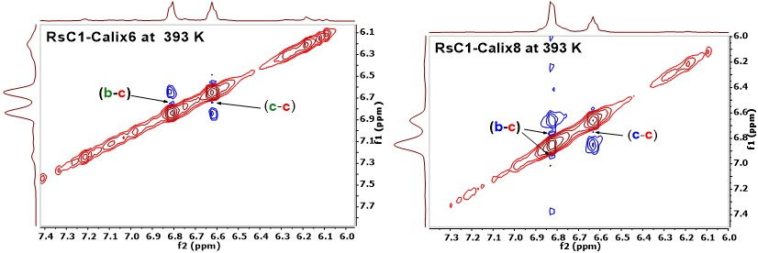
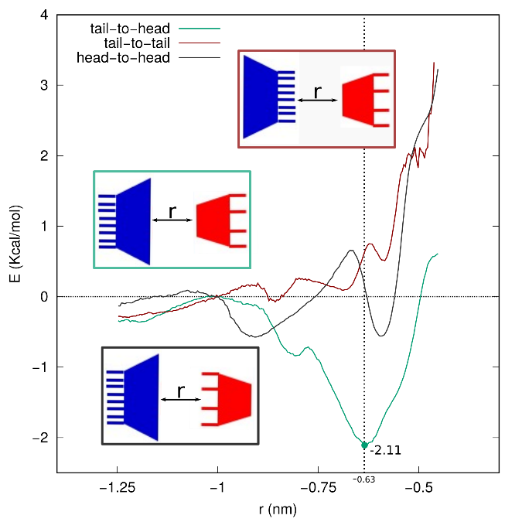
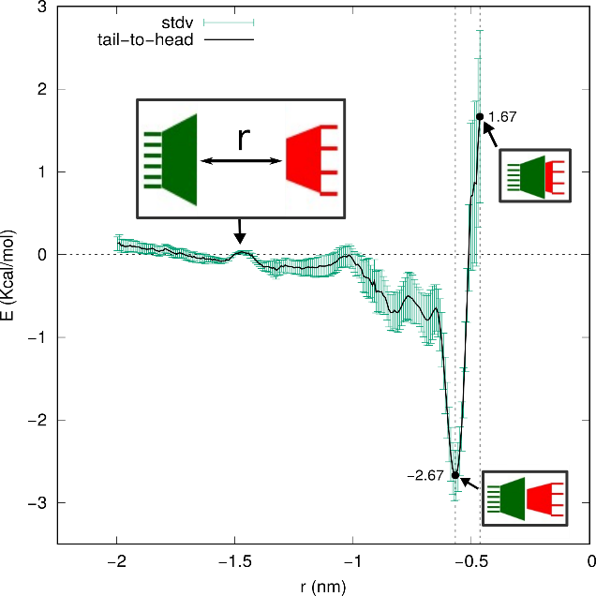

Calix-n-Arene self-assembly results
Experimental results show, via NMR and visual inspection, that in solution both RsC1 / Calix6 and RsC1 / Calix8 mixtures some complexation is occurring.
Umbrella simulations show that for both RsC1 / Calix6 and RsC1 / Calix8 mixtures there is a significant
favorability for two macrocylces to interact in a Tail to
Head (TH) conformation.
-2.11 kcal/mol for RsC1 / Calix8
-2.07 kcal/mol for RsC1 / Calix6
The orientation preference seems to be driven by
steric blocking and solvent competition (hydrogen bonding to methanol/dmso)
Resulting Publication
Dawn, A., Eisenhart, A., Mirzamani, M., Beck, T.L. and Kumari, H., 2018. Bowl-in-bowl complex formation with mixed sized calixarenes: adaptivity towards guest binding. Chemical Communications, 54(52), pp.7131-7134.

Slide 15
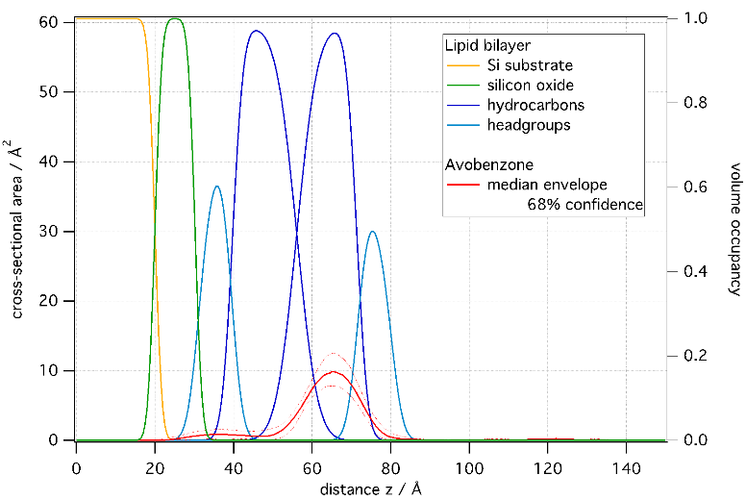
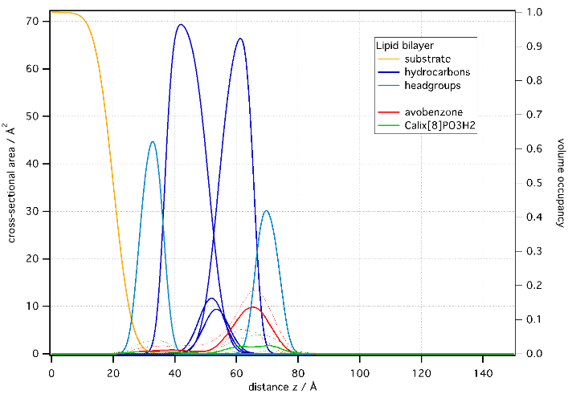
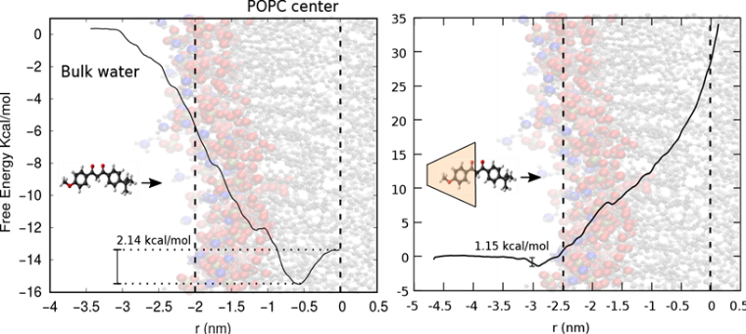
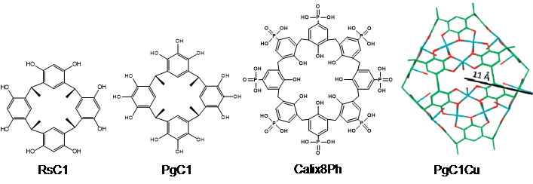
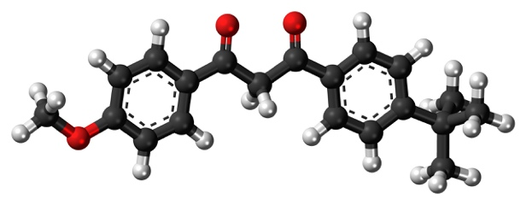
Calix-n-Arenes as avobenzone chaperone results
Neutron Scattering data suggests that the avobenzone by itself partitions to a position ~0.6nm from the bilayer center. When Calix8Ph is added Avobenzone penetration is reduced, and Calix8Ph stays associated with the lipid head groups.
MD simulations confirm the ~0.6nm distance via PMF. Once complexed there is no favorable position for the Avobenzone and Calix8Ph complex inside the bilayer rather they sit favorably at the bilayer surface.
Resulting Publication
Kumari, H., Eisenhart, A., Pajoubpong, J., Heinrich, F. and Beck, T.L., 2020. Investigating partitioning of free versus macrocycle bound guest into a model POPC lipid bilayer. RSC Advances, 10(26), pp.15148-15153.

Slide 16
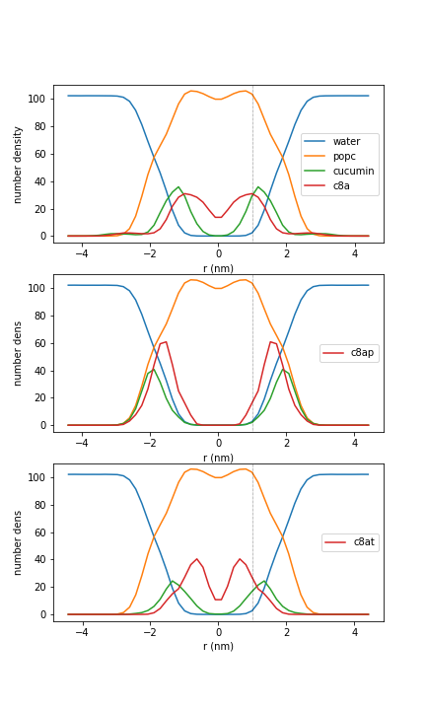
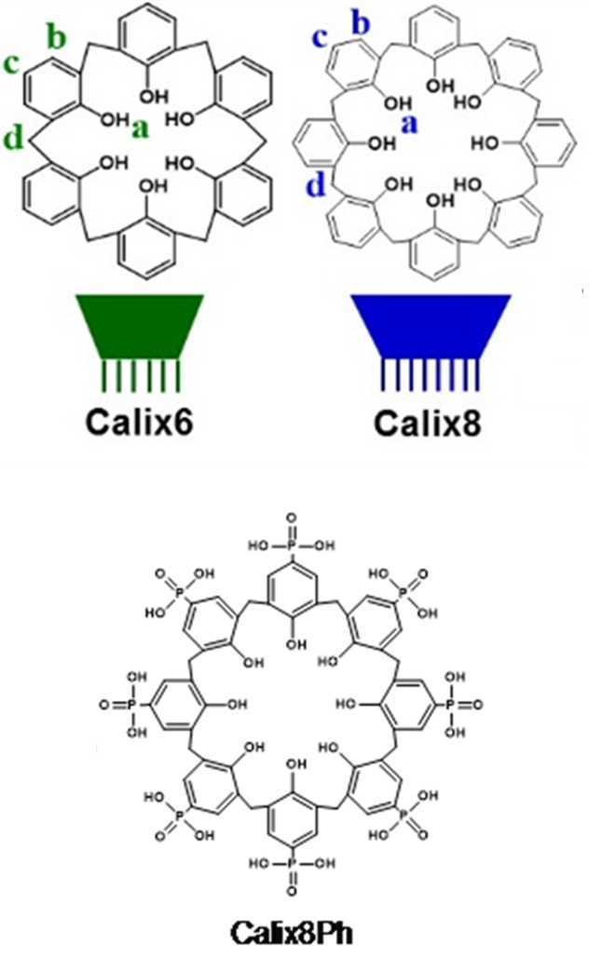
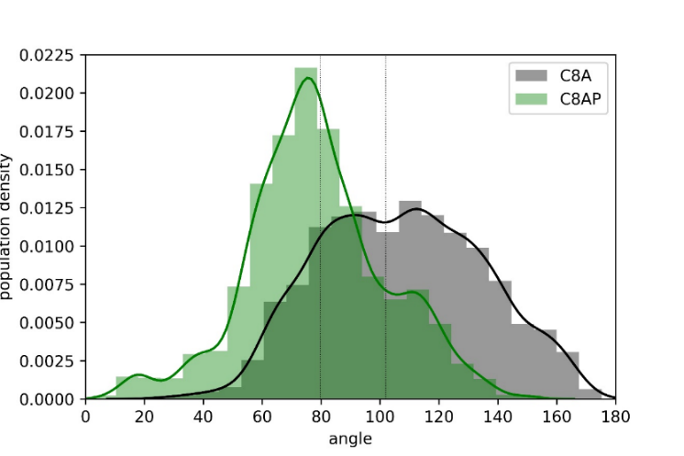
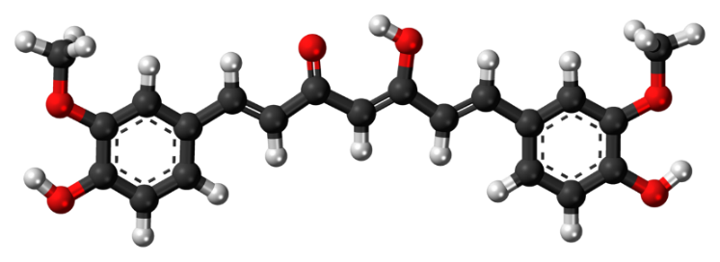
Calix-n-Arenes as curcumin chaperone results
Molecular dynamics results
Curcumin penetration depth order (from bilayer center)
Calix8 chaperone (1.25nm) > Calix8-tb (1.8nm) > No chaperone (1.84nm) > Calix8Ph (1.95nm)
>
>
>
No chaperone
Calix8
Calix8-tertbutyl
Calix8-Ph
Calix8 rotates more freely inside the bilayer then Calix8-Ph
Awaiting skin permeation study for Publication
Curcumin

Slide 17
Project 3 : Phenothiazines
Tuning next generation charge carriers for redox flow batteries
in collaboration with the Jiang group

Slide 18
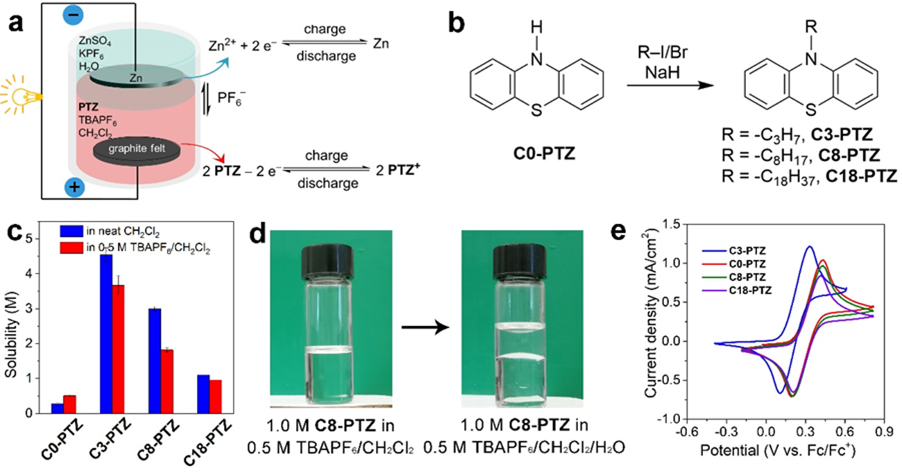

Redox Flox Batteries
Redox flow batteries address the need for cheaper and scalable energy storage created by the push for renewable (intermittent) energy sources.
Energy stored in electrolyte can be cycled in and out of use allowing for long term storage.
Currently suffer from cost and capacity limitations
Advantages of the Zn/Phenothiazine Battery
The more hazardous organic phase is covered with the aqueous phase.
The catholyte at the bottom avoids direct expo-sure of organic electro-active material to atmospheric dioxygen and mitigates any dioxygen diffusion
The solubilizing ability of CH₂Cl₂ complements other more commonly used organic solvents in RFBs, expanding the solvent pool for high electrolyte concentration in RFBs.

Slide 19
Project Goals
Detail the solvation of Phenothiazine derivatives by water and dichloromethane
Quantify the effect of tail functionalization on phenothiazine derivatives solubility in water and dichloromethane.
Methodology
Classical molecular dynamics (GROMACS md suite, OPLS-aa force field) to probe solvation structure around phenothiazine derivatives
Quantum Electronic calculations of ∆G_{solv} (gaussian/g16d01). Carried out with the M052x/cc-pVTZ and HF/6-31G(d,p) methods, and using the SMD formulation to correct for solvent effects.

Slide 20
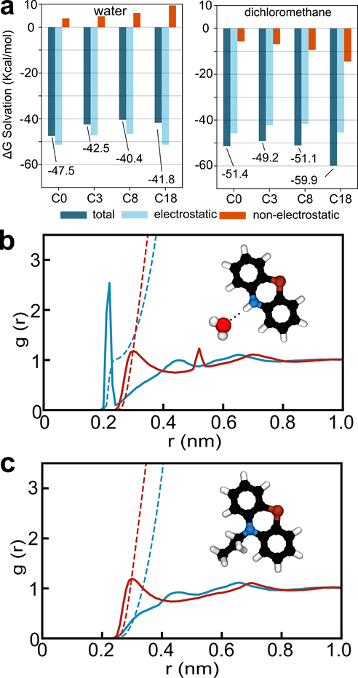
Phenothiazine solvation in organic and aqueous solvents results
The Biphasic, Membrane-free Zn/Phenothiazine Battery has shown to be capable of stable long cycling and a capacity retention of 79.1%.
Study of phenothiazines with varying length of alkyl chains (C₀, C₃, C₈, and C₁₈) reveals that the hydrophobicity of the phenothiazine molecules greatly affects the solubility in dichloromethane and battery cyclability.
Functionalization of the tail blocking hydrogen bonding is shown to have a larger effect on water solvation free energy than in dichloromethane. This allows phenothiazine to be tuned for organic solvation without increasing the viscosity of the electrolyte to unusable levels.
Resulting Publication
Journal: ACS Materials Letters
Manuscript ID: tz-2021-000615
Title: "Biphasic, Membrane-free Zn/Phenothiazine Battery. Effects of Hydrophobicity of Redox Materials on Cyclability"
Authors: Chai, Jingchao; Lashgari, Amir; Eisenhart, Andrew; Wang, Xiao; Beck, Thomas ; Jiang, Jianbing
Manuscript Status: re-Submitted (under review)

Slide 21
Resulting work and future work recap
GC liquid structure and solvation of KF/KCl
Biphasic phenothiazine based redox-flow batteries
Journal: The Journal of Physical Chemistry
Part: Part B: Biophysics, Biomaterials, Liquids, Soft Matter
Title: "Quantum Simulations of Hydrogen Bonding Effects in Glycerol Carbonate Electrolyte Solutions"
Authors: Eisenhart, Andrew; Beck, Thomas
Manuscript ID: jp-2020-10942d.R2
Manuscript Status: Accept
Journal: ACS Materials Letters
Manuscript ID: tz-2021-000615
Title: "Biphasic, Membrane-free Zn/Phenothiazine Battery. Effects of Hydrophobicity of Redox Materials on Cyclability"
Authors: Chai, Jingchao; Lashgari, Amir; Eisenhart, Andrew; Wang, Xiao; Beck, Thomas ; Jiang, Jianbing
Manuscript Status: Submitted
Calix[n]Arene self assembly
Dawn, A., Eisenhart, A., Mirzamani, M., Beck, T.L. and Kumari, H., 2018. Bowl-in-bowl complex formation with mixed sized calixarenes: adaptivity towards guest binding. Chemical Communications, 54(52), pp.7131-7134.
Experiments To Finish
GC liquid structure and solvation of Li⁺, I⁻, PF₆⁻ plus insights into the role of the second solvation shell on liquid dynamics
Li⁺, I⁻, PF₆⁻ AIMD Simulations finished
Classical complements to be run
Calix[n]Arene : avobenzone chaperone
Kumari, H., Eisenhart, A., Pajoubpong, J., Heinrich, F. and Beck, T.L., 2020. Investigating partitioning of free versus macrocycle bound guest into a model POPC lipid bilayer. RSC Advances, 10(26), pp.15148-15153.
Calix[n]arenes as a chaperone for curcumin membrane penetration
All simulations finished

Slide 22
Thesis / Dissertation Outline
Chapter 1 – Introduction
1.1 Ion solvation driving forces (hofmeister)
1.2 Modern Energy storage methods, materials, and challenges (Li⁺ Batteries, EC/PC)
1.3 Glycerol carbonate as a novel green solvent
Chapter 2 – Hydrogen Bonding’s Impact on Liquid Structuring and Dynamics in pure and electrolyte GC
Chapter 3 – Hydrogen Bonding Impacts in Macrocycle Dynamics and Host-Guest Interactions
Chapter 4 – Tuning Liquid Electrolyte Phase Separation Through Tail Functionalization.

Slide 23
Time Line
Feb 3rd Closed Defense
Feb 16th Deadline to apply for graduation
March 2nd Submit Dissertation to committee for review
March 16th Electronic Dissertation submission deadline
April 7th Deadline to announce Open Defense
April 21st Open Defense

Slide 25
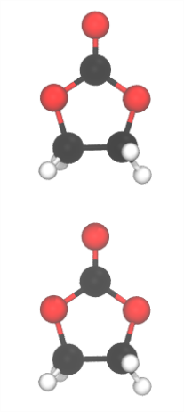

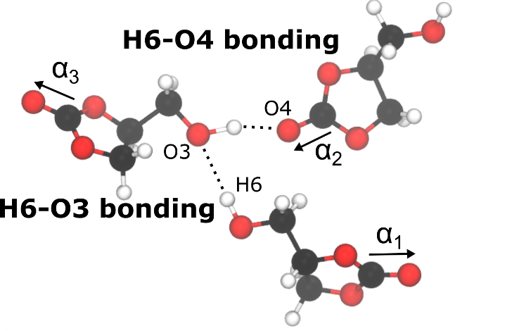

AIMD - RevPBE/DZVP-MOLOPT-SR-GTH
Organic carbonate possible interaction modes
(a)
(c)
(b)
Interaction modes
“chain forming” hydrogen bonding (a)
“Stacking” VDW bonding (b)
2 other hydrogen bonding
conformation (H6-O3 and H6-O4)
“disordered” (c)
EC
PC
GC
GC
Quantify H-bonding interactions
using
Radial Distribution Functions
Increased peak height
=
Increased Interaction

Slide 26


Which liquid structure results from these interactions?
Compared to EC and PC, GC forms no long range “chains”
Which present in region (b) below
Compared to EC, PC and GC show “stacking” only in one direction
What does this mean for the physiochemical properties of GC?
Lack of molecular chain formation due to the hydroxyl group of GC leads to a lower melting point, but the strength of hydrogen bonds lead to a high viscosity.
This effect is enhanced by the lack of bi-directional stacking in GC and PC compared to EC

Slide 27

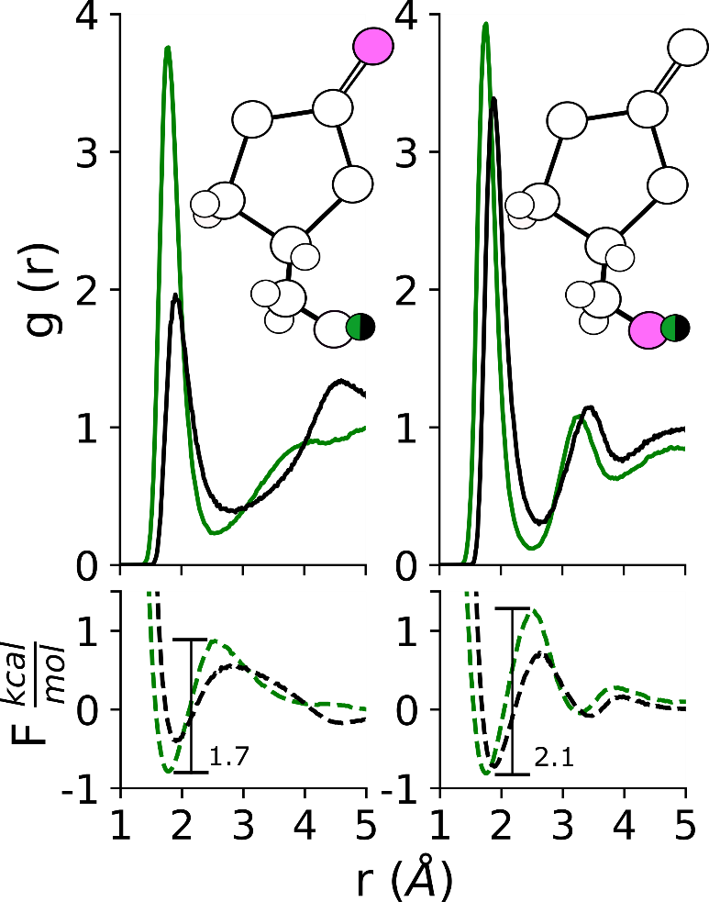
AIMD / Classical simulations vs Experiment
Dynamic Quantities
Method | Self-Diffusion Coefficient (Å² /ns) | Viscosity (cP)
Classical (OPLS-aa) | 19.6* | 12.46 ± 0.9
RevPBE | 1.4* | -
Experiment | 0.89** | 85.00 [1]
* - This work, **- estimated via Stoke-Einstein relation using experimental ŋ and molecular radius of 3 Å
1. Sonnati, Matthieu O., et al. "Glycerol carbonate as a versatile building block for tomorrow: synthesis, reactivity, properties and applications." Green Chemistry 15.2 (2013): 283-306.

